Slide 1
Configuring components and component processes

Slide 2
Components describe what gets deployed
Application
Application process
Component
Environment
Component processes
Component processes
Resources
Steps
Agent
Properties
Properties
Component
Versions
Versions
Files
What
Notes:
This section focuses on components, which are containers for deployable items and their deployment instructions. A component usually contains a closely related set of artifacts, and you would deploy its content on a single target.

Slide 3
Each component represents artifacts from a single source
Component tiers of an application
Application
Web
component
Database
component
Application
component
Images and static content
SQL
Application WAR file
Notes:
An application consists of a break down of components. In this example, the application has three component tiers: one for the web content, one for the database content, and one for the application content. This arrangement gives flexibility to deployments. You can see what versions of each component are deployed to specific environments. The benefit of HCL Launch is that it manages the source file and identifies which files have changes. Then, it deploys only the changed files.

Slide 4
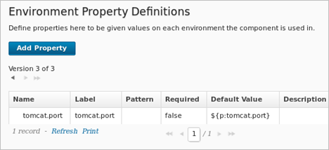
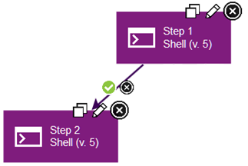
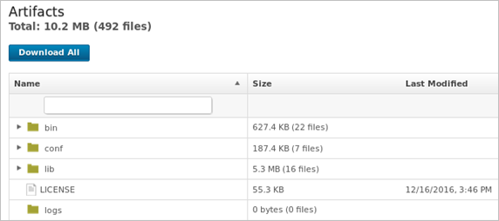
A component contains versioned files, component processes, and properties
Component
Component processes
Steps
Properties
Versions
Files
Notes:
From a high-level view, a component has three major parts: versions, component processes, and properties.
A version contains a set of artifacts. Versions ensure that the appropriate set of files get deployed.
A component process is a list of commands that run on a target computer. Steps can manipulate files, run system commands, download files, and run programs.
Properties are variables that store the locations of files, folders, servers, or other resources that might change.

Slide 5
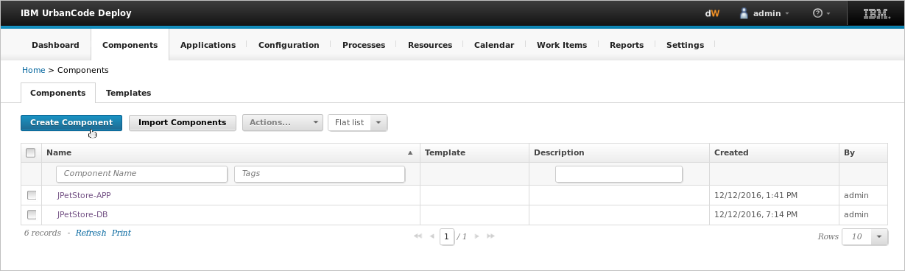
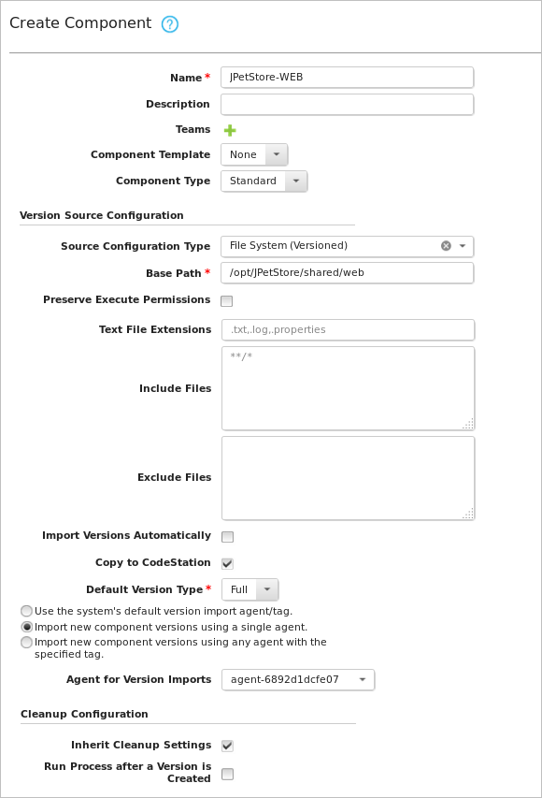
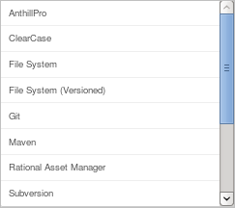
Component artifacts can come from various source-code management sources
Notes:
When you create a component, you identify its type of artifacts and the location of the artifacts. In most cases, you add components by connecting the server to the system that hosts the artifacts, such as github, jfrog, etc .
In the Create Component window, you’ll need to consider a few things:
Component Template: First, you decide if you want to base a new component on a template. Templates allow you to reuse component processes and properties and can save you time when you create many components with a similar set of attributes.
Source Configuration Type: The Source Configuration Type identifies the location of the artifacts. You can choose from many different source control systems.
Import Versions Automatically: If you select the option to Import Versions Automatically, the source location is periodically polled for new versions. Any versions that are found are automatically imported.
Run Process after a Version is Created: In conjunction to automatically importing versions, at the bottom of the window, you can choose to run a process after a version is created. You specify an environment and an application process. Then, any time a new version is automatically imported, the process runs. You can use this to automatically deploy a new version any time it’s created.
Copy to CodeStation: By default, a complete copy of the content is imported into CodeStation, which leaves the artifacts in their original location untouched. CodeStation is the embedded artifact repository in HCL Launch. It tracks file versions and maintains a complete history for all components.
Default Versions Type: When you import a version, it can be full or incremental. You make this selection in the Default Versions Type field before you even import the component. A full version contains all component artifacts. An incremental version contains only artifacts that are different from the previous version. It’s additive, like a patch.

Slide 6
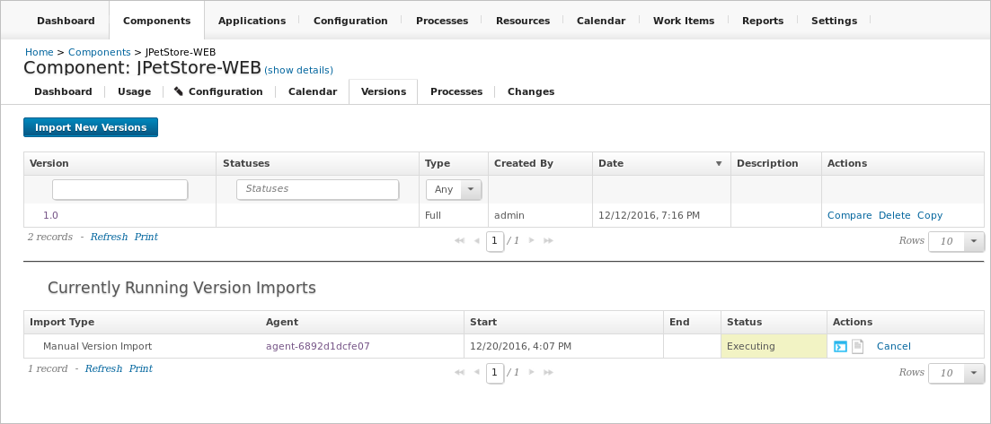
Components have versions that ensure the appropriate component instances are deployed
Current component version
Import process for latest component version
Notes:
After you define the source for a component, you import its artifacts on the Versions tab. Each time a component is imported, including the first time, a new version of the component is created. This is called versioning.
To manually import a new version, you click Import New Versions. The status of the import process displays in the Currently Running Version Imports section. You can see the agent that is importing the component.

Slide 7
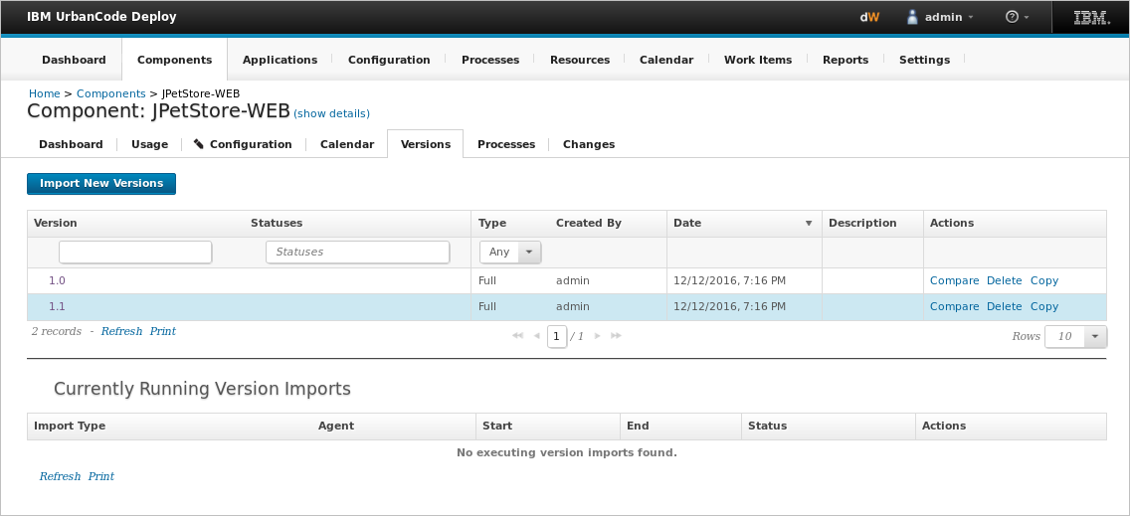
A new version of the component is created every time a component's artifacts are modified and imported
New component version successfully imported
Notes:
A component might have several versions in CodeStation, and each version has a unique set of files.

Slide 8
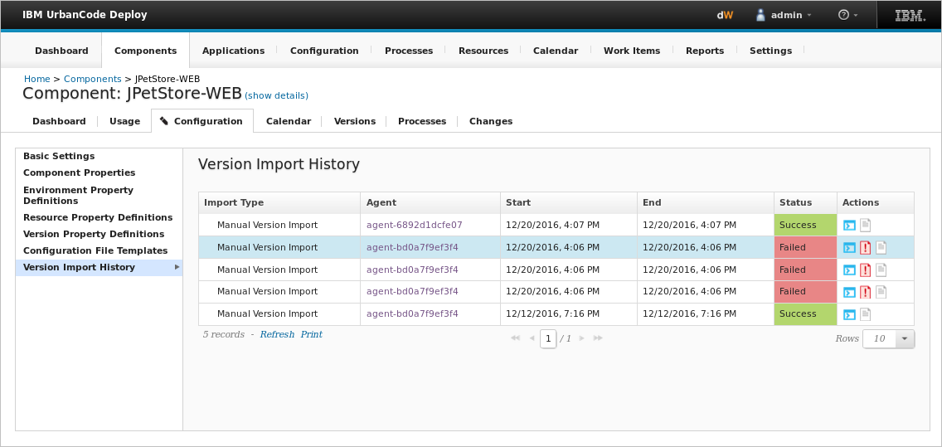
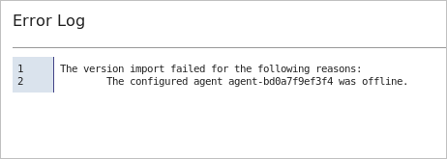
The version import history shows the status of attempted imports
Notes:
You can see the version import history in the Configuration tab. If the version import failed, you can view the error log. Make sure that the files are available on the agent system and that the location of these files is correct on the component.

Slide 9
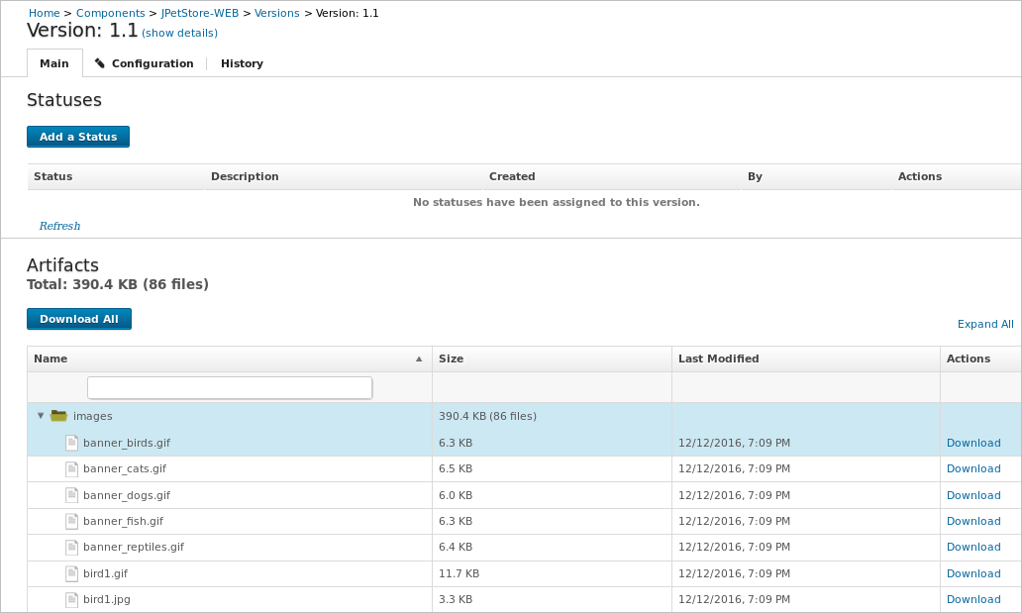
A version contains a set of deployable artifacts
Notes:
After a version is imported successfully, click the new version to view the files that were imported. Versions let you see all of the files that are associated with a component. In this example, the images for the web server are listed in the Artifacts section.

Slide 10
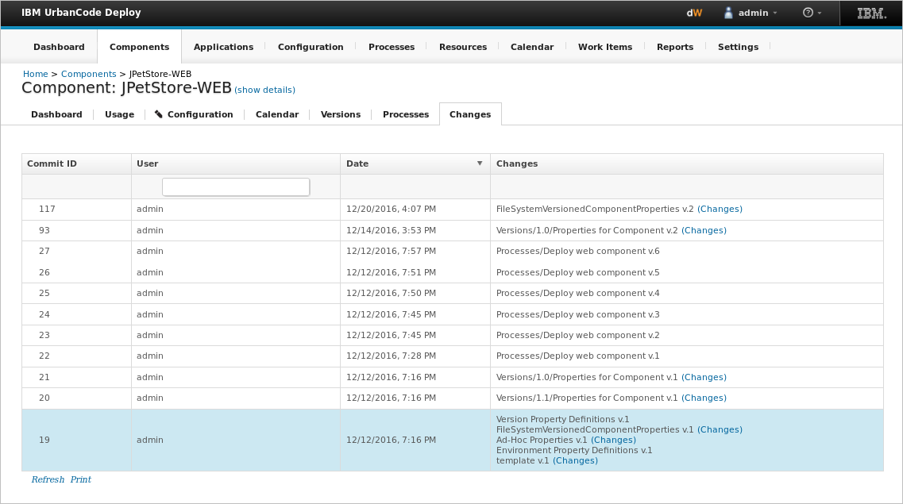
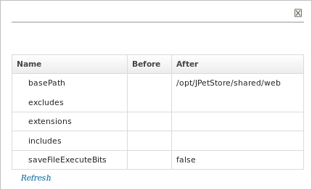
Change logs provide information about modifications to components
Notes:
The Changes tab tracks changes made to the component. You can see who modified the component and the date and time the change was made. This provides you with an audit trail of who is changing things. In this example, you can see that the basePath property was changed.

