Slide 1
An environment associates components with an agent on the target host
Application
Application process
Component
Environment
Component processes
Component processes
Resources
Steps
Agent
Properties
Properties
Component
Versions
Versions
Files
Where
Notes:
The environment explains “where” of the application model. First, you need to configure an agent. After that, you can create the resources and environments. Next, you associate the resources with the environments.

Slide 2
Environments can have different topologies, configurations, and settings
UrbanCode Deploy
Single Server
SIT environment
DB
WAR
APP
DB Server
Web Server
UAT environment
DB Server
Web Server 1
PROD environment
Load balanced
Web Server 2
Notes:
An environment is the application's mechanism for bringing together components with the agent that deploys them. Now that you have an agent with mapped components, you can create the environments and associate the resources. Environments typically include host systems and agents. When a deployment is run, it is always done so in an environment.
Environments can have different topologies.
The diagram shows three different server topologies:
The SIT environment has a single server with an installed agent that contains all three components: Database, Web, and Configuration.
The UAT environment has two servers with an installed agent on each. The database server contains the database component and the web server contains the web and configuration components.
The PROD environment has a more distributed and production-ready topology. Each server has an installed agent with the database server that still contains the database component, but there are load-balanced web servers that each contain a web and configuration component.

Slide 3
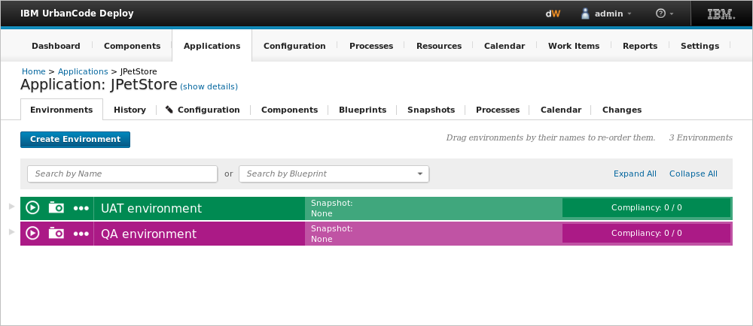
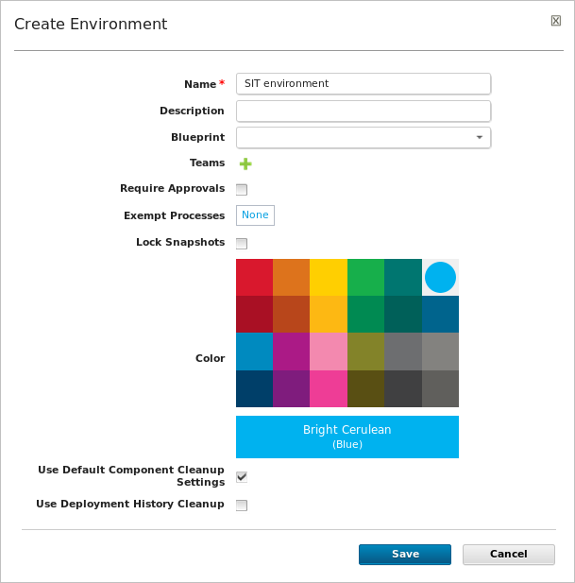
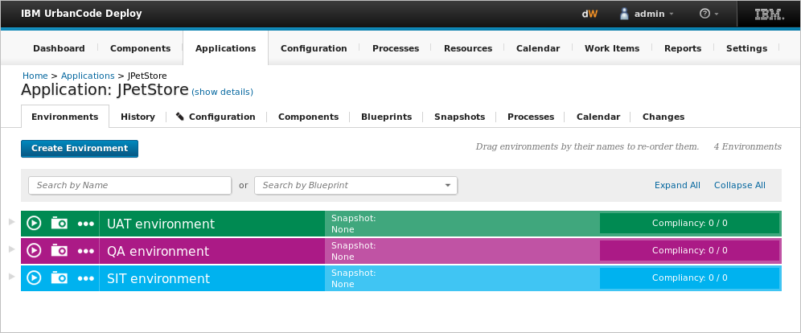
Environments represent the target to which your files are being deployed
Notes:
You create an environment for each target to which you deploy an application. Environments are typically modeled on some stage of the software project lifecycle, such as development, quality assurance, or production. The initial environment is typically uncontrolled and often is used to create snapshots. A snapshot represents a set of component versions that are known to work together.
Creating an environment involves selecting one or more agent resources with mapped components.

Slide 4
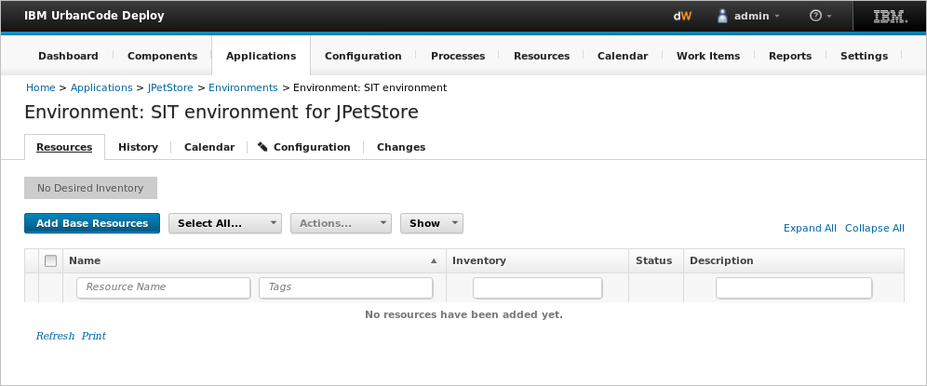
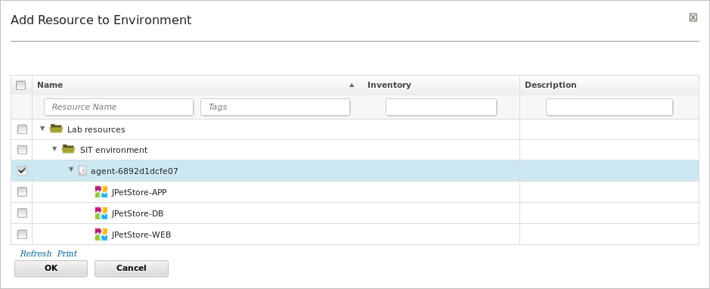
Mapping resources and components to the environment provides a topology
Agent with mapped components
Notes:
Before you can run a deployment, you must define at least one application environment that associates components with an agent on the target host.

