Slide 1
Component processes deploy, configure, or uninstall component versions
Deployment
Deploys the specified component version to the target resource
Configuration Deployment
Applies a configuration inventory to a deployed component
Uninstall
Removes the component version from the target resource
Operational (with version)
Operational (no version needed)
Does not add or remove artifacts from the inventory; it runs steps on a currently deployed component
Same as the Operational (with version) type, except that this type does not use a component version
Notes:
At this point, you created your components and imported the versions. So, how does the actual deployment happen? You deploy components with component processes. Processes define what HCL Launch does with a component's artifacts. For example, a component process can run tasks on a single component, such as deploying it, uninstalling it, or running configuration tasks on it.

Slide 2
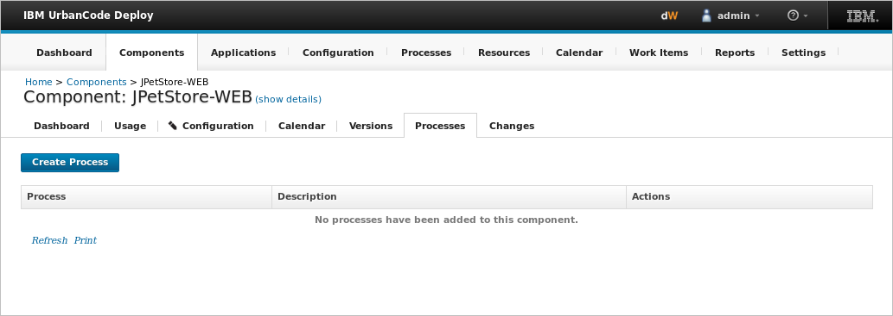
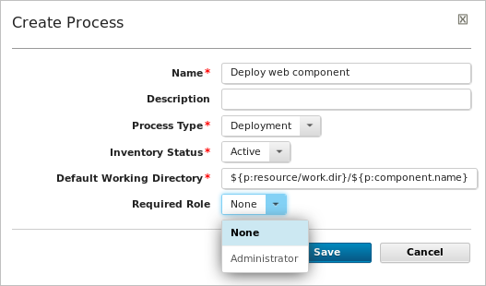
Components contain processes that perform operations on component files
${p:resource/work.dir} is the default working directory for the agent
${p:component.name} is the component name
Notes:
You create a component process in two steps: first, you configure basic information, such as the name and process type; then, you use the process editor to assemble the process. A component process is defined for a specific component.
When you create a process, you need to set a few things:
Process type: The process type determines how the component handles updating the inventory in HCL Launch . This is where you decide if your process will deploy components or configuration, or if it will uninstall a component.
Inventory status: The Inventory status is a status that is applied to a component version after the processes successfully runs. An Active status indicates that the component version is deployed to its target resource.
Default working directory: The default working directory defines the location that the agent uses to run the process. You can see the default value in the example, where ${p:resource/work.dir} is the default working directory for the agent and ${p:component.name} is the component name. (The default value resolves to agent_directory\work\component_name_directory and is stored in the componentProcess.defaultWorkDir property.)
Required role: You can set a value in the Required Role field to restrict access to a specific role of users who can run this process. The available options are derived from the HCL launch security system. The default value is None, meaning anyone can run the process.

Slide 3
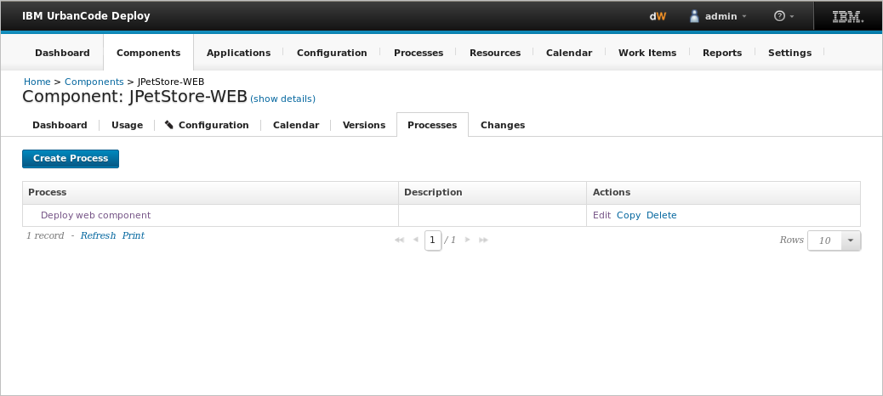
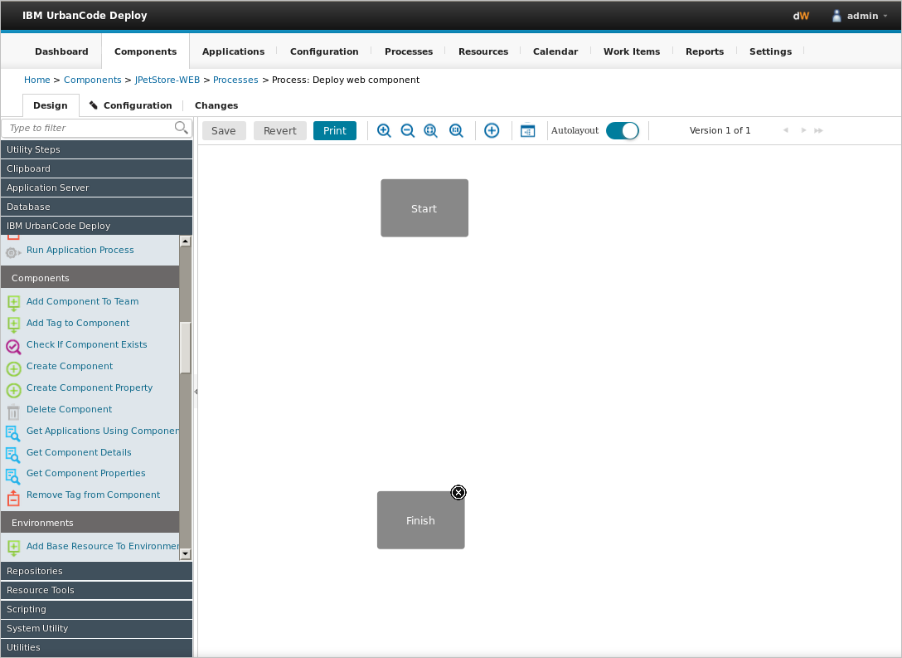
Component processes are created with the process editor
Notes:
Component processes are created with the process editor. To open the process editor, click the process name. The process editor has a Steps palette on the left and a design space on the right. A process begins with the Start step and must end with the Finish step.

Slide 4
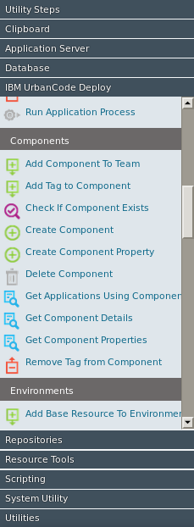
Process steps are selected from a menu of standard steps that replace typical deployment scripts and manual processes
Notes:
The available steps in the palette are determined by the installed plug-ins. Plug-ins consist of distinct processes called steps. Each step consists of a number of properties, a command that runs the step, and post-processing instructions. Step properties can serve various purposes, from providing input to the command to supplying some, or all, the actual command itself.
Some plug-ins are included with the product, but you can install others. HCL Launch provides steps for several utility processes, such as inventory management, and workflow control.

Slide 5
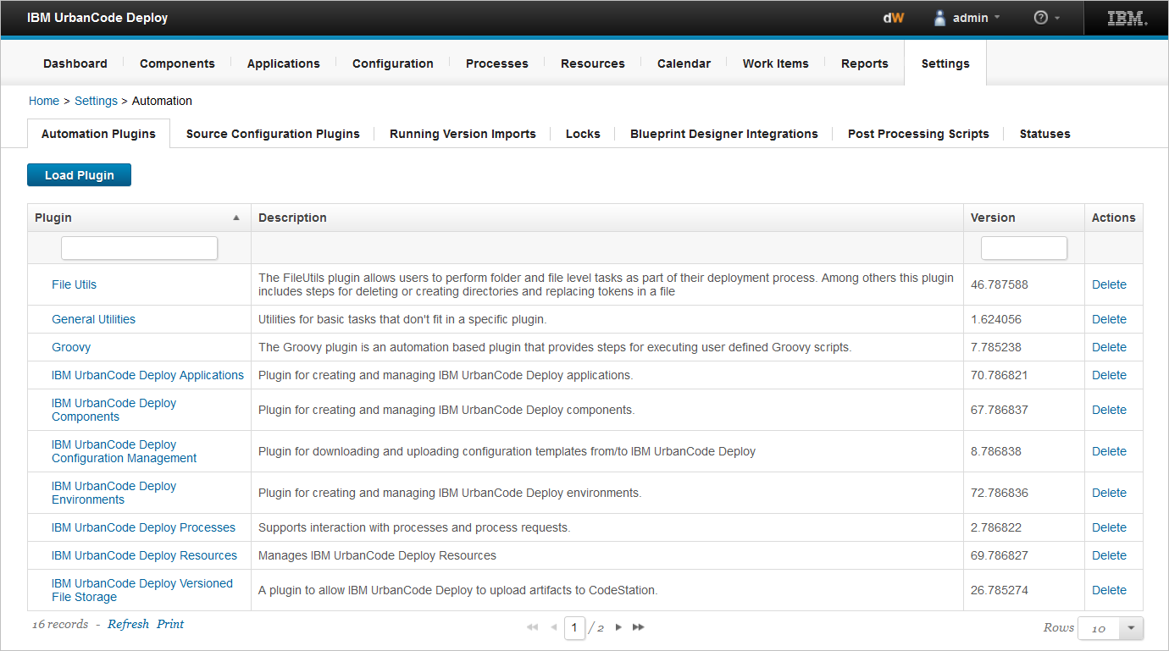
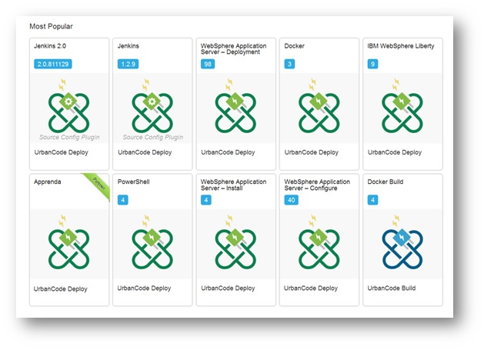
A number of plug-ins come with the product and many others are available that can be downloaded and installed
Notes:
Other process steps are provided by plug-ins that provide integration with DevOps tools and technologies of Delivery pipeline . A full list of plug-ins can be found on this address: https://plugins.hcltechsw.com/
Plug-ins provide processing and integration functions. There are two types of plug-ins:
Source-type plug-ins integrate with external systems to import artifacts and create component versions. Source-type plug-in properties are typically defined when a component is created.
Automation-type plug-ins provide process steps that manipulate components, typically by deploying them. Automation-type plug-in properties can be set at design time in the process editor, or at run time in the user interface.

Slide 6
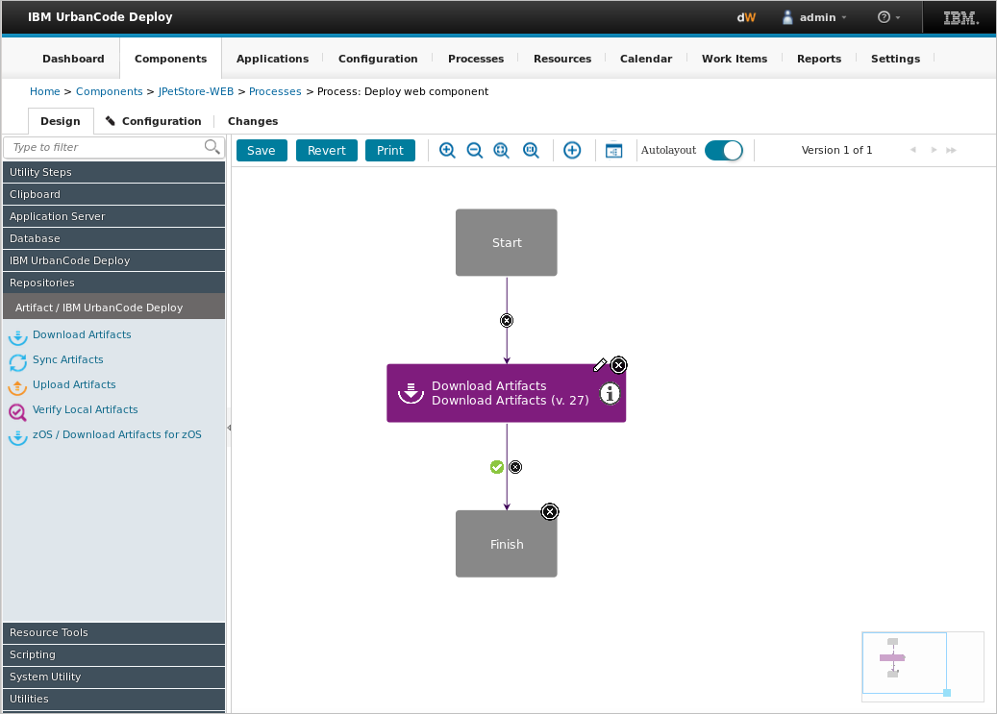
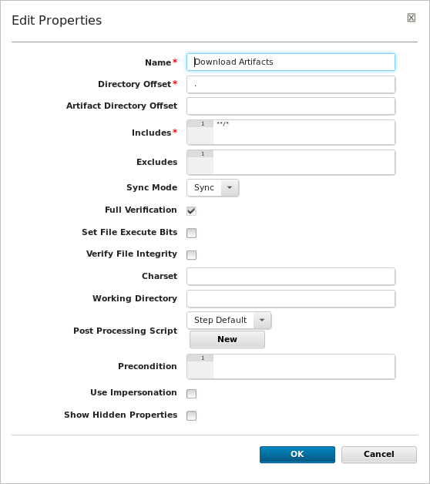
The palette provides automation steps that you can drag onto the process editor
Notes:
The process editor is a visual drag-and-drop editor where you can drag process steps from the palette onto the design space and configure them as you go. As more steps are placed, you visually define their relationships with one another.
When you drag a step into the process editor, you can edit the fields for that step. In this example, the Download Artifacts step is prepopulated with information that you can use.

Slide 7
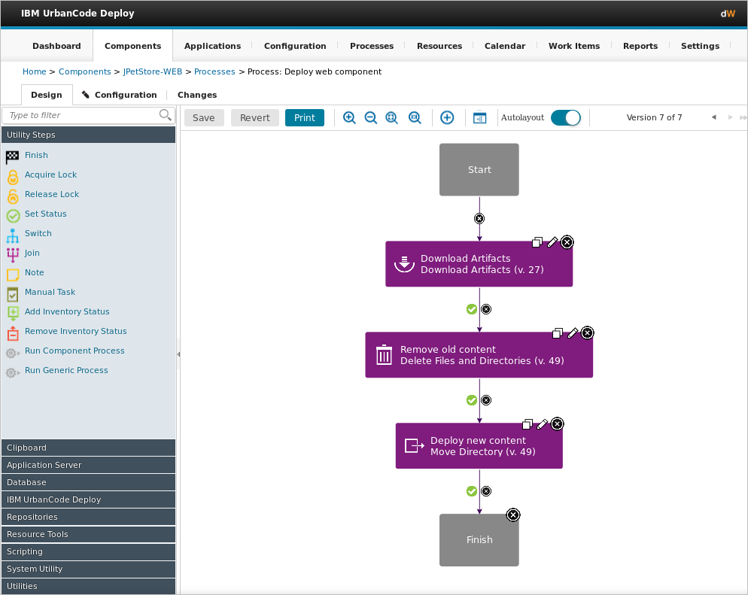
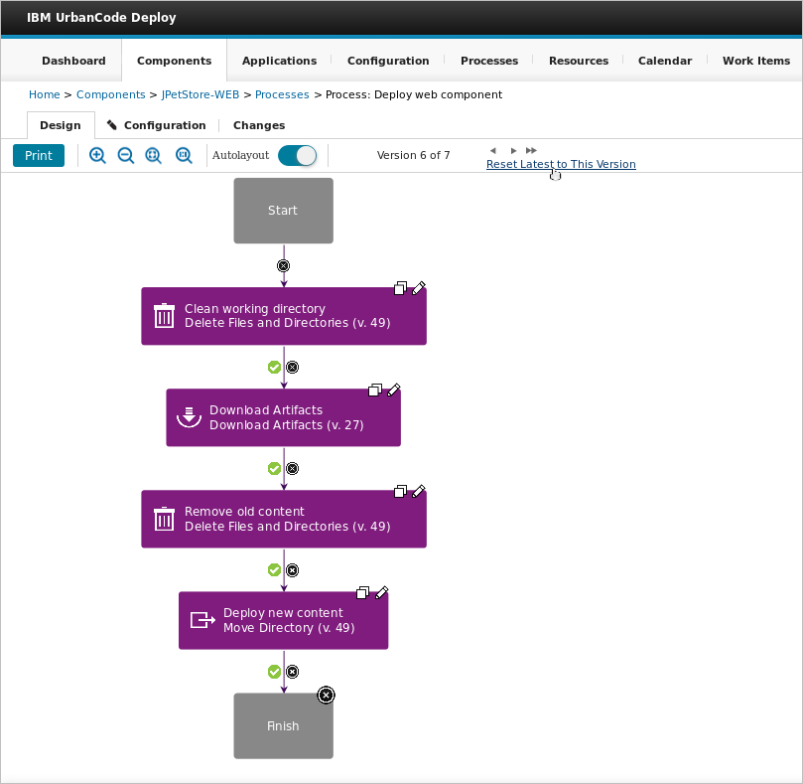
Processes are versioned artifacts
Current process version in use
Reset to any process version
Notes:
Each time that you save your process, a new version of that process is saved. You can scroll through the versions to view them and then reset to any process version that you previously saved.

Slide 8
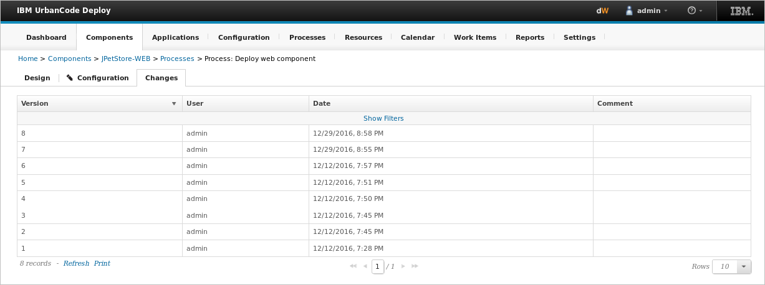
The Changes tab tracks the creation date and author of the versions
Tracks who made changes and when
Notes:
When a process is created, information is gathered to inform when a change was made and who made it.

Slide 9
Processes use different kinds of steps and joining techniques
Conditional processes
The conditional flag sets a condition on a connection
Switch steps
Branch processes, based on the value of a property
Branching steps
Process step properties
Preconditions
Branch processes so multiple steps run at the same time
Items that a post-processing script finds in the step's output log
Preconditions determine whether the step runs
Post-processing scripts
Post-processing scripts run after a step finishes
Merge processes to return to running a single step at a time
Joining steps
Notes:
A component process can be as simple as a single step or contain numerous relationships, branches, and process switches. When you design processes, you use different kinds of process steps and joining techniques.

Slide 10
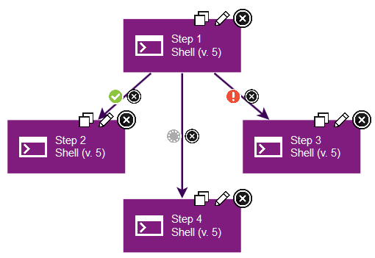



Conditional processes use flags to set conditions on connections
Process succeeded
Process failed
Either success or fail is acceptable
Notes:
By default, all connections between steps have the flag set to succeeded, which is the green circle with a check. This means that the originating step must finish processing before the next step starts to process. If you set the flag to failed, which is the red circle with an explanation point, then the step must have a failed process to reach the next step in that branch. And if you set the flag to a gray circle, the process moves to the next step, whether the previous step’s process completed or failed.
The possible conditional flags are as follows:
Success: The process is complete.
Fail: The process did not finish.
Both: The process is Complete or the process did not finish. Either status is acceptable, and the next step can start.

Slide 11
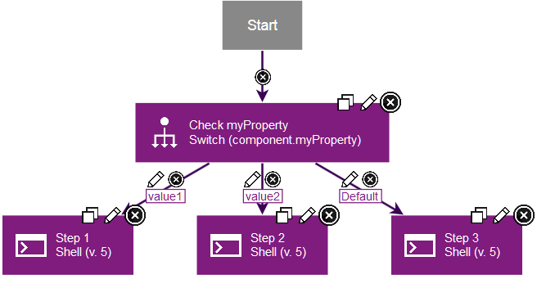
Switch steps branch processes based on the value of a property
Switch step with specific property check
Possible values for the property
Notes:
When you add a switch step, you specify a property. Then, you add two or more outgoing connections from the step, each with a possible value for that property. At run time, the process follows the connection with the matching property value.

Slide 12
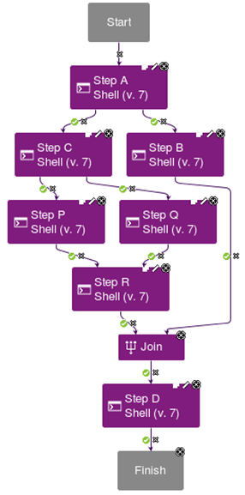
Branching steps runs multiple steps at the same time
Both branches, Step B and Step C, run at the same time
Steps P and Q merge at Step R, which runs if either Step P or Q succeeds
All connections up to this point must reach this step to process Step D
Notes:
You can branch processes so that multiple steps run at the same time by adding multiple outgoing connections from a step. You can use a Join step to merge processes into running a single step at a time. Join steps indicate that all connections to the Join step must succeed. If any of the steps that connect to a Join step fail or do not run, the Join step causes the process to fail. In this example, all steps leading up to Steps R and B must complete, as Steps R and B both connect to a Join step.

