Slide 1
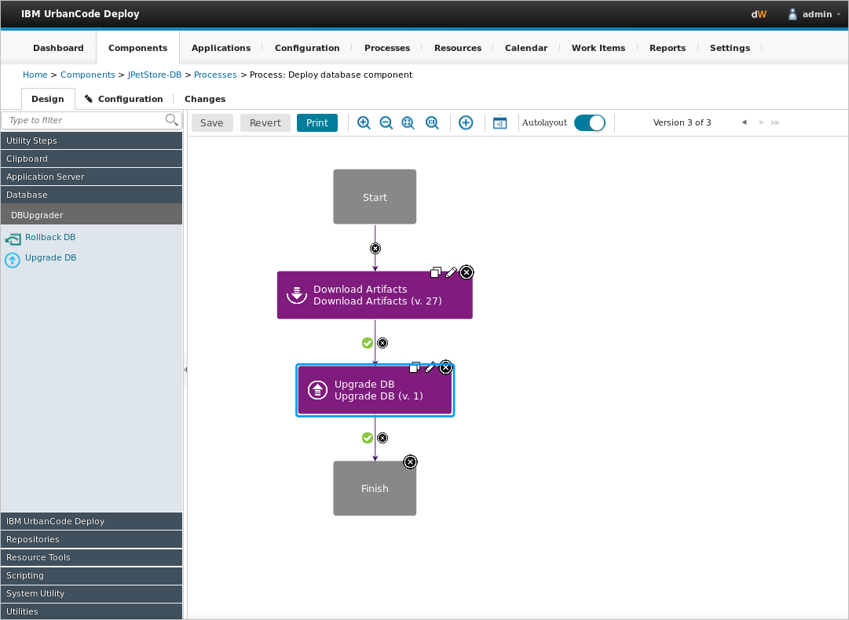
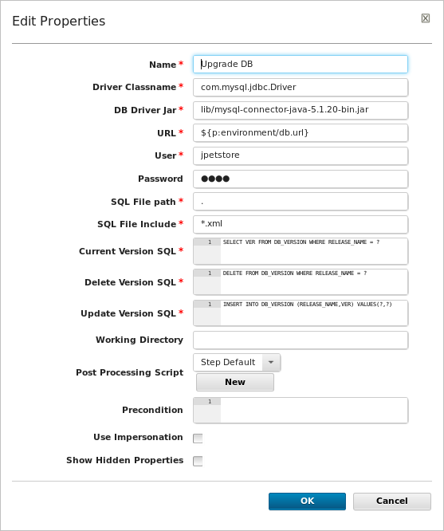
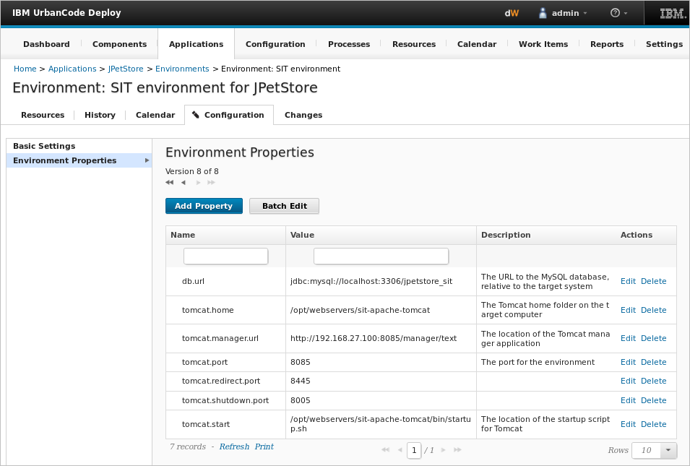
Properties are variables that store information about different elements
Properties are pointers within a step to a predefined property
Properties that are defined for specific environments
Notes:
Properties are pointers to values. They store information about components, environments, processes, applications, and global properties for the system. In this example of a component step, the URL field points to a value that is defined for the environment. At run time, the environment property, in this case the db.url value, will be substituted here.

Slide 2
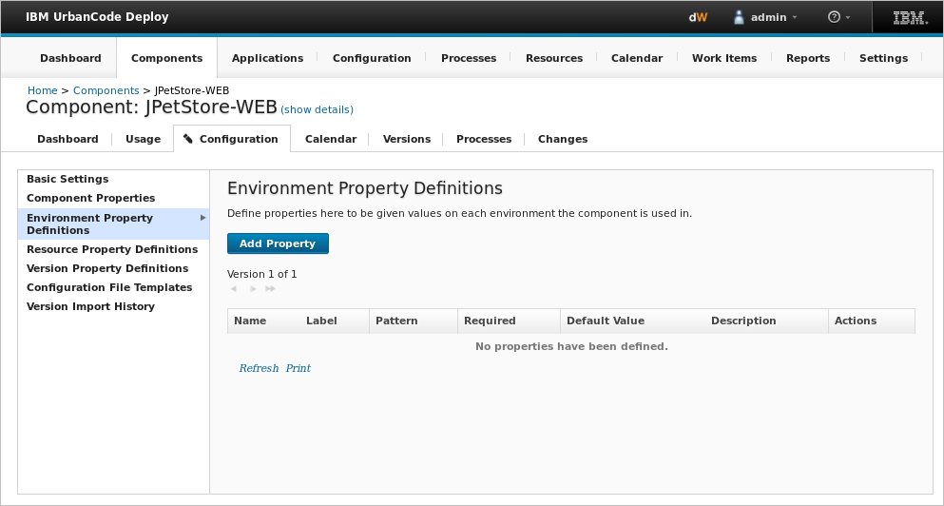
Components can have several types of properties
Component property types
Component
Environment
Version
Resource
Notes:
Component properties: Component properties are values defined and set directly on the component. They stay the same for all versions of the component. So, any time you import a new version, the properties are already set.
Property definitions: Components have a special type of property called property definitions. Component property definitions can be used for environments, versions, and resources. You use definitions when you have a value that the component uses that needs to change each time you use that component. These properties are defined on the component, but their values are set in other places. For example, Component environment properties are defined on a component, but the values are not specified until the component is deployed to an environment. In the previous slide, the URL field pointed to a predefined environment property called db.url. This allows you to assign a different database URL to each environment. You might want to do this if you have a test database at one URL for your development environment and a production database at another.
For example, if different database users have access to the development and test databases, you can set the database user name and password in each environment. Then, you use a component environment property to point the correct database URL for each environment. is different in every environment (DEV, QA, SIT, etc.)
Component version properties are defined on a component, but the values are specified on component versions. This type of property stores information that changes with each version of the component, such as a version number. Each component version can have a different value for its component version property.
Component resource properties are defined on components, but they are not given a value until the component is added to an environment as a resource. Then, the property behaves much like a resource property. Because a component can be added to an environment multiple times, each instance of the component can have a different value for the component resource property. If you need to use two copies of a component in the same environment but use a different value between them, use a resource property definition.

Slide 3
Properties are referred to by scope
Property notation
Component
Version
Resource
${p:component/propertyName}
Environment
${p:environment/propertyName}
${p:version/propertyName}
${p:resource/propertyName}
${p:elementType/propertyName}
location
property name
${p:environment/db.url}
Notes:
Properties are referred to by scope. Scope is the type of artifact that contains the property, such as the environment or component. When you refer to a property, you use the notation that starts with a dollar sign, open curly brace, p, which stands for property, and then a colon. Then you identify the artifact, followed by a slash, the property name, and a closed curly brace.
${p:component/prop.name}, where the “p” stands for “property.” It says to look in this location with this name.
Keep in consideration where values change; that is where you want to set the properties.

Slide 4
Properties can also be referred to without scope
Property notation with scope
Property notation without scope
${p:elementType/propertyName}
${p:propertyName}
location
property name
property name
${p:environment/db.url}
${p:db.url}
Notes:
There might be situations where you don’t want to reference a specific artifact. In this case, you can refer to a property without scope by leaving out the artifact (${p:propertyName}). For example, with the environment variable, db.url, you can refer to it with the artifact name, environment, as you see on the left (${p:environment/db.url}). Or you can refer to the same environment variable without scope by removing the artifact name, as shown in the right (${p:db.url}). In this way, you can refer to properties defined in other places, such as in the application, system, or resource.

Slide 5
Property scope determines the precedence of properties with the same name
4
5
Processes
Component version
Resource
Agent
Environment
Component
Application
System
Scope
3
6
2
7
Highest
1
8
Lowest
Notes:
If a property is defined in multiple places, its value is determined by the property’s order of precedence. The order of precedence allows you to override properties in specific contexts. If you refer to a property without scope, then the property with the highest order of precedence is used.
This slide shows the order of precedence from highest to lowest. The highest precedence is given to properties that are referenced in processes. The lowest precedence is given to properties referenced in the system.
In this way, you can override properties to change the application behavior without changing the code. For example, an application might have a database for testing and a separate database for production use. In this case, you might create an application property, such as databaseLocation, to store the testing database location. The application and component processes can refer to the property without specifying the application scope, like this: ${p:databaseLocation}. Then, in the production environment, you can override the application property with an environment property that specifies the production database location. The processes still refer to ${p:databaseLocation}, but in the context of the production environment, the environment property takes precedence, so the application uses the production database.

Slide 6
Properties are primarily set from the Configuration tab
You can also set properties here:
Processes
Rest API and command line
Output properties
Notes:
you can set properties in the following locations:
Configuration tab: You can manage properties for applications, components, and environments
Processes: Several different steps are available to create and set properties in processes
REST API and command-line client: Several commands in the REST API and in the command-line client can set properties
Output properties: You can pass properties from one step to another within a process
Properties for applications, processes, components, component versions, resources, and agents are available on their respective configuration tabs. System (global) properties are available on the Settings tab at the top of the page, by clicking Settings > Properties.

