Slide 1
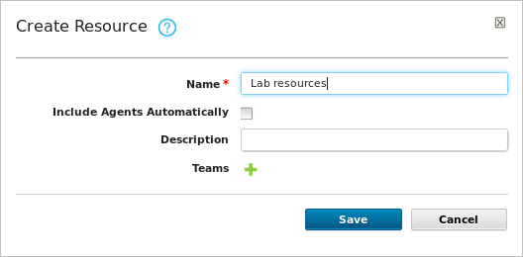
A resource tree organizes what is being deployed and to where
Top-level container
Notes:
Resources are created on the Resource Tree tab. Resources associate agents with components. After they are mapped to an application environment, they provide deployment targets.

Slide 2
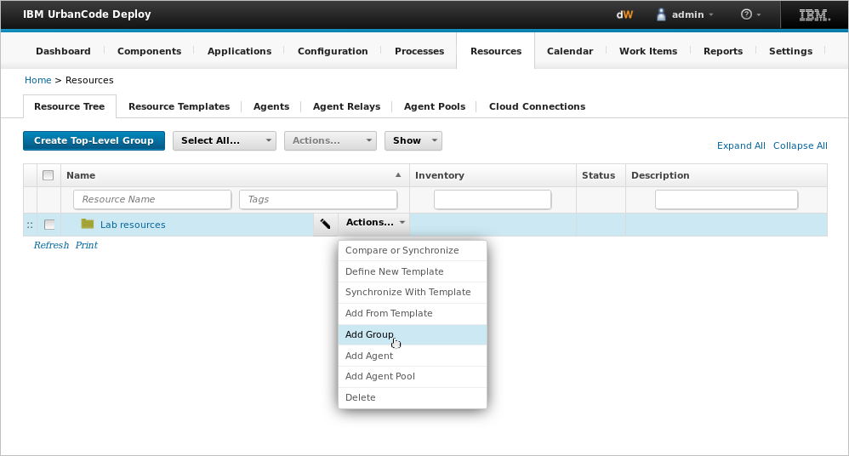
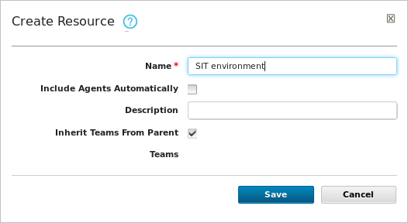
Resource groups enable collections of resources to be easily reused
Notes:
First, you create a top-level group for all the resources within that group. A resource group is a useful organizational element. You can break down a complex environment into a number of blocks and manage them across hundreds of applications.

Slide 3
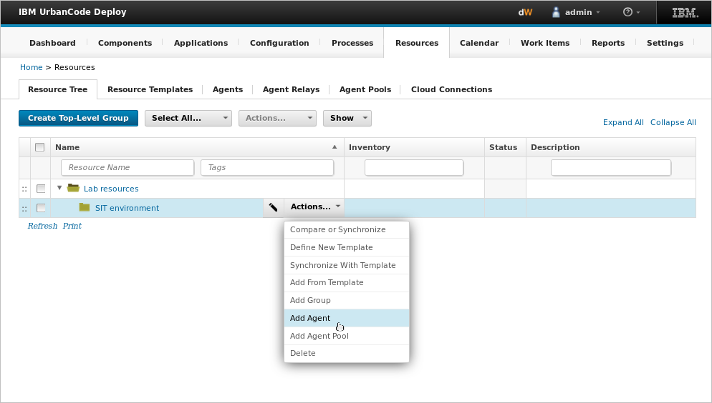
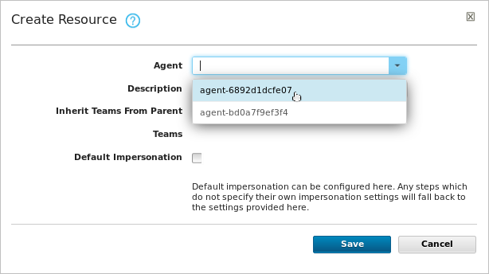
Agent-type resources represent the computers where components are deployed
Notes:
Next, you add an agent. An agent lives on a resource and performs deployment operations.

Slide 4
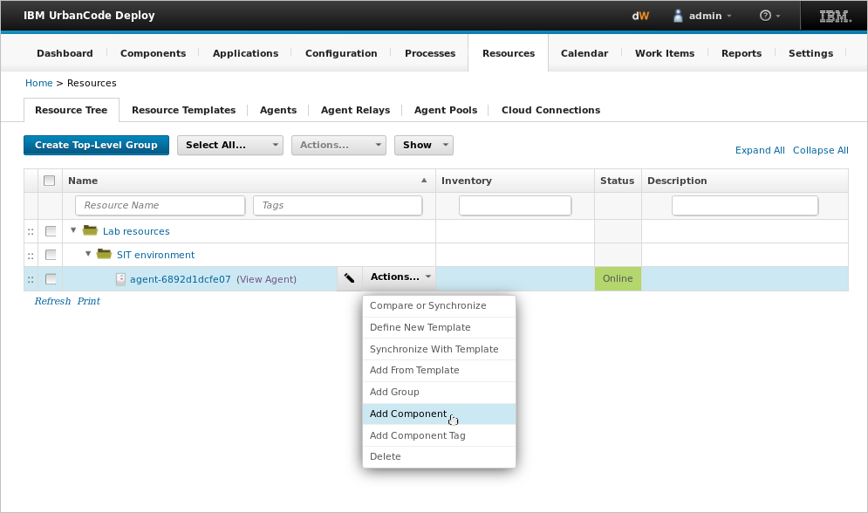
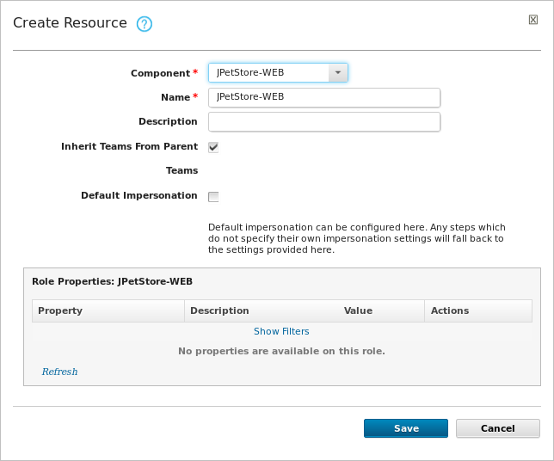
Component-type resources represent the components that are deployed to target environments
Notes:
Finally, you associate the components. A component-type resource can point directly to the agent or agent pool that deploys it, or it can point to another resource in a hierarchical chain of resources.

Slide 5
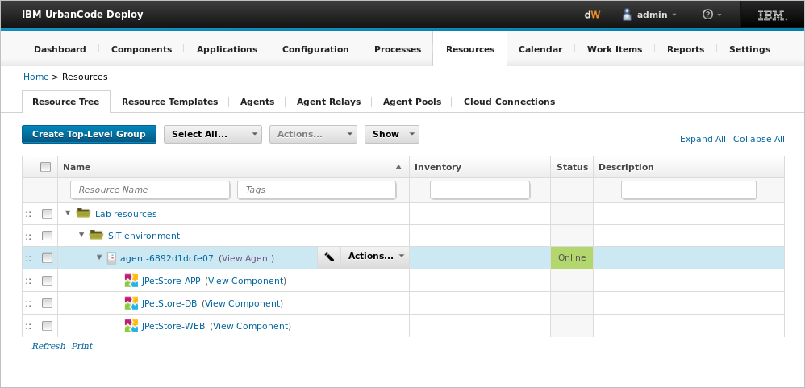
The Resource Tree page displays resources in a hierarchical tree structure
Resource group
Agent
Components
Notes:
A resource tree shows a hierarchical representation of the mapping between logical and physical. Each row in a resource tree represents a resource and has an Action menu that is associated with it. The available actions depend on whether the resource represents an agent, agent pool, component, or organizational group.

Slide 6
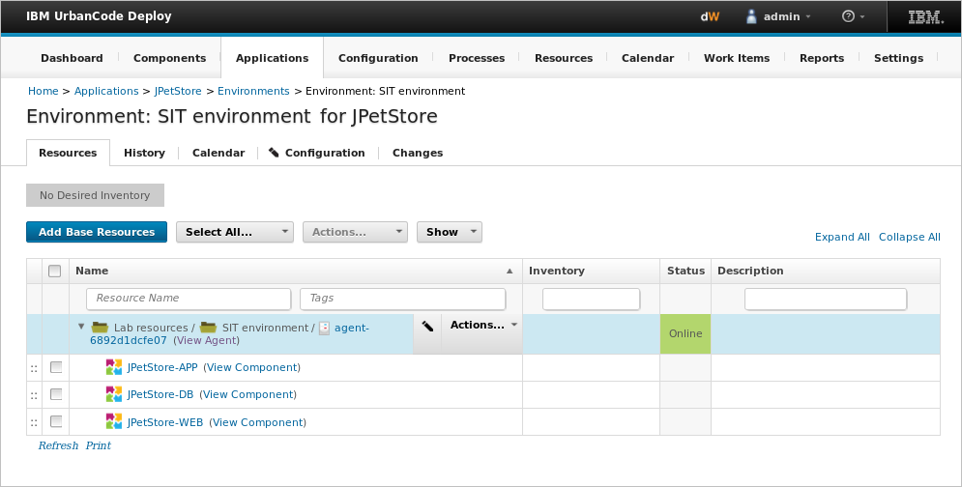
Resources associate agents with components
Agent
Components that the agent will deploy to an environment
Notes:
After components are mapped to an application environment, resources provide the deployment targets.

