Slide 1
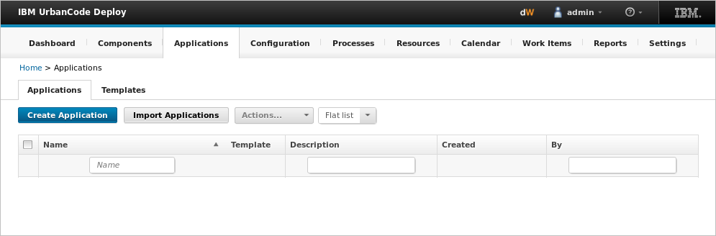
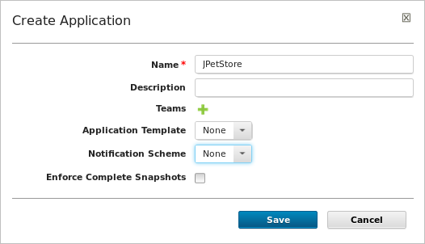
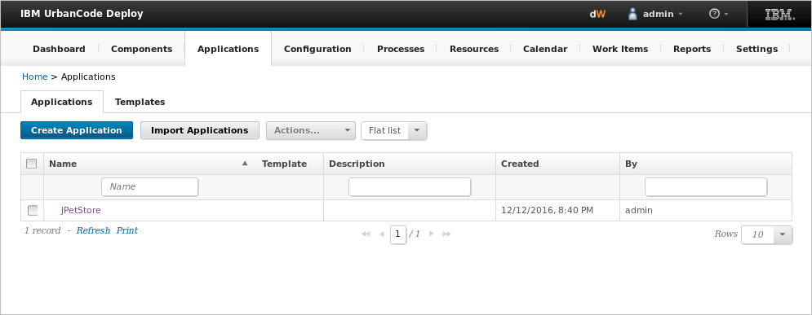
Applications associate resources with environments and define processes to run deployments
Application container
Notes:
An application is a container for components, processes, and resources. When you create an application, you determine a few things:
You’ll want to identify who has access to the application. You can grant access to teams, and you can set the application security type.
You decide if you want to base your application on a template. Application templates can help you to be sure that new applications contain the types of components, environments, and resources that you specify. You can also specify the application properties, environment properties, and environment gates for an application.
You can choose to use a Notification Scheme. A notification scheme sends out notifications that are based on events, such as when an application deployment fails or succeeds.

Slide 2
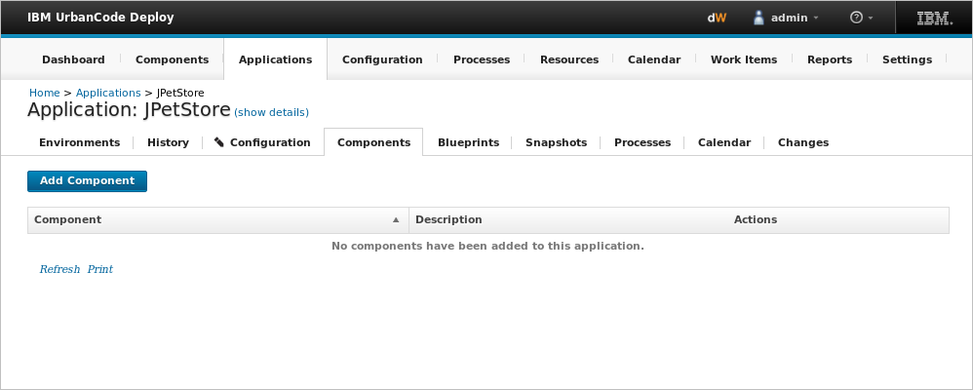
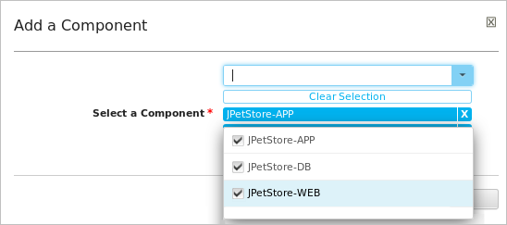
An Application groups components together
Associates components with an application
Notes:
After defining the application, itself, the next step is to identify the components that it manages.

Slide 3
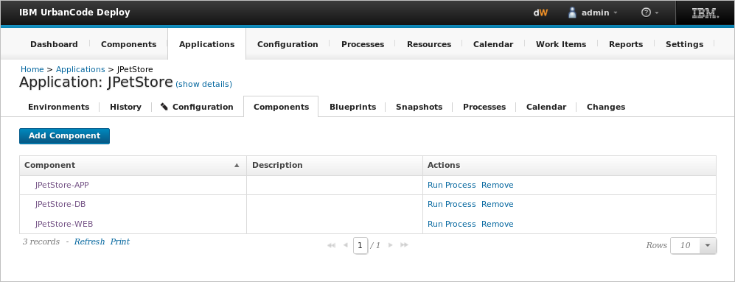
Applications manage components and map the dependencies between them
Components available to the application
Notes:
When you associate components with an application, they are available to be used in deployments.

Slide 4
The Application process is the how of the application model
Application
Application process
Component
Environment
Component processes
Component processes
Resources
Steps
Agent
Properties
Properties
Component
Versions
Versions
Files
How
Notes:
In this next section, we look at application processes, which describe the application model.

Slide 5
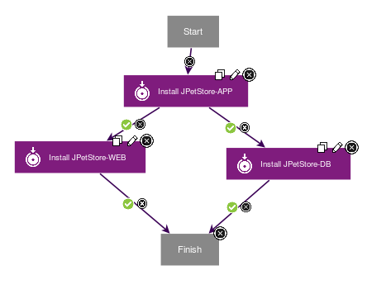
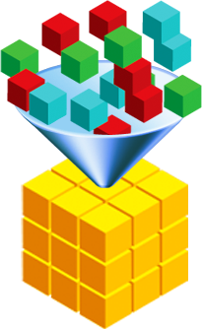



An application process determines what components are deployed together
Components
Composite
application
Notes:
When you create application processes, you not only determine which components are grouped together, but you also identify the flow of the deployment. Component processes are run in a particular order as managed by the application process.

Slide 6
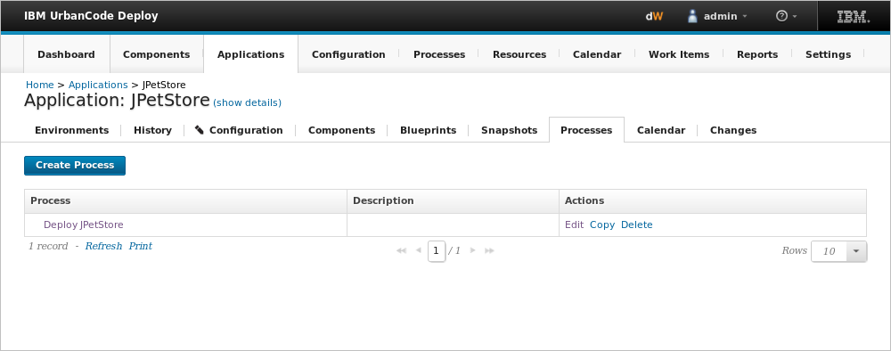
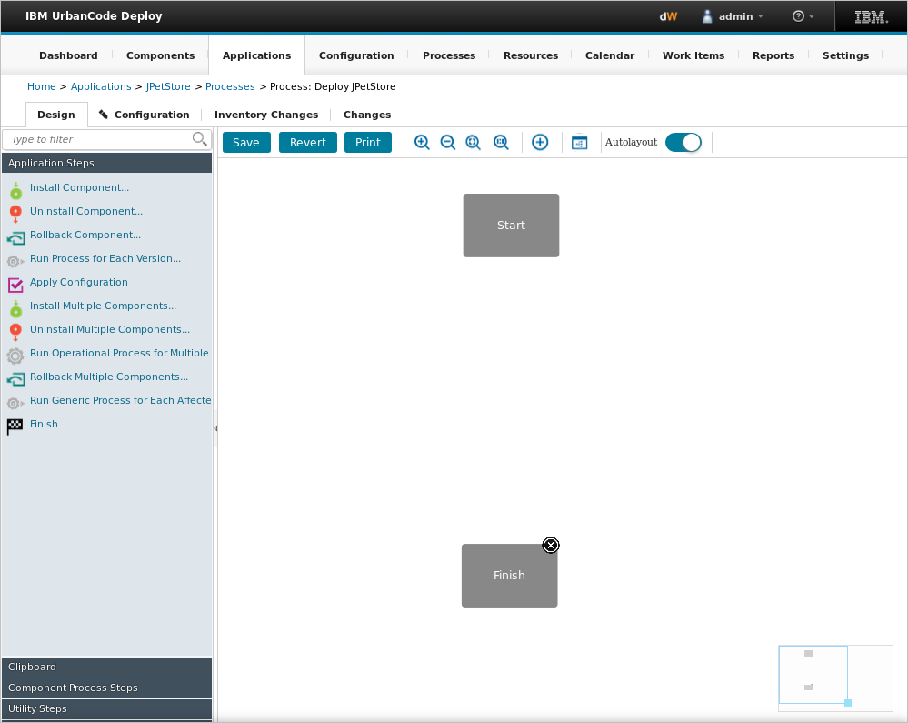
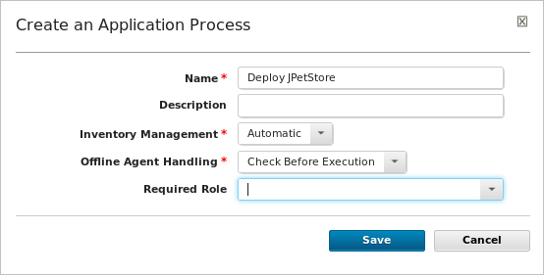
Application processes are created with the process editor
Notes:
Application processes, like component processes, are created with the process editor. They are authored with a visual drag-and-drop editor and composed of steps that call the component processes.
Similar to component processes, you can use several step types, such as:
Conditional processes
Switch steps
Branching and joining steps
Process step properties
Post-processing preconditions

Slide 7
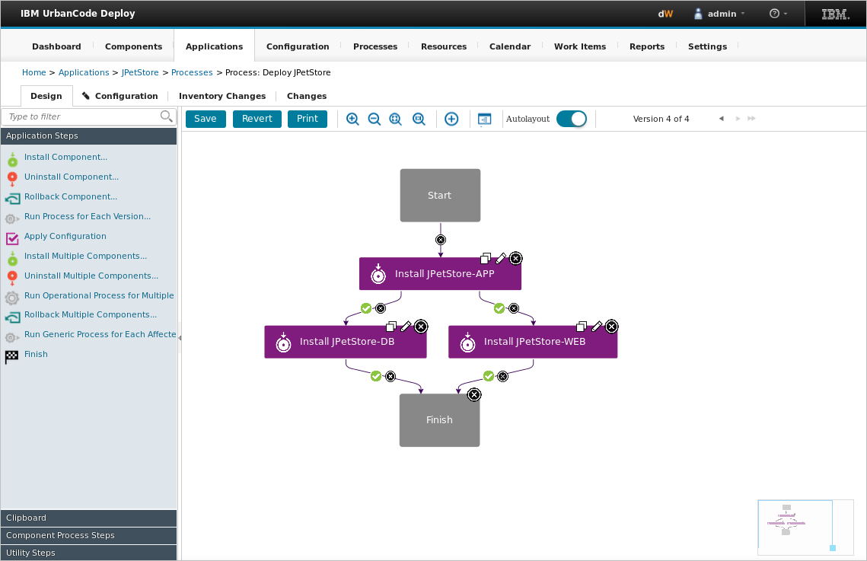
Application processes provide overall deployment orchestration
Process editor
Palette
Notes:
An application process plays a coordination role. Steps in an application process represent the various component processes and tasks that are required to complete a deployment. While it looks like a component process, these steps are not from plug-ins. Steps for applications are part of HCL Launch .

Slide 8
With all of the application pieces in place, you are ready for deployment
Application
Application process
Component
Environment
Component processes
Component processes
Resources
Steps
Agent
Properties
Properties
Component
Versions
Versions
Files
How
What
Where
Notes:
With all the details in place ,
How to deploy , What to deploy and Where to deploy . We are ready to go ahead with the deployments .

